Slide 1
Airbnb Property Listing Analysis
CS-GY 6513 - Big Data (Section D)
Fall ‘23
Team
Anirudh Iyer (avi2011)
Asish Boggavarapu (ab10535)
Shruti Wagle (sgw6735)

Slide 2
Project Statement
In recent years, Airbnb has become a significant participant in the hospitality sector by offering millions of long and short-term accommodation listings globally. Data-driven insights can help property hosts find suitable guests and visitors find their desired stay. Using the Airbnb Global Listings dataset from Kaggle, we aim to provide a deep understanding of the dynamics within the vacation rental marketplace. We offer insights that hosts, travelers, and other stakeholders can utilize to leverage their respective positions within the hospitality industry.
Through this project, we aim to comprehensively explore and analyze the dataset to extract valuable insights and patterns. The project comprises exploratory data analysis (EDA) and various data-driven technological stacks to uncover trends, behaviors, and correlations that can inform decision-making and help strategize cutting-edge development plans. We employ big data technologies such as Apache Spark and PySpark to fulfil our objective.

Slide 3
Objective
Our goal is to gain insights into the issues below and answer relevant questions on the following sub-topics that will be beneficial to property managers, guests, and industry stakeholders that use the platform:
● Pricing Trends: Analyze pricing patterns across different regions, and property types, to identify pricing strategies.
● Property Type Insights: Investigate the types of properties available (e.g., entire homes, private rooms, shared rooms) and how travelers utilize them.
● Sentiment Analysis: Assess the sentiment and content of guest reviews to gauge satisfaction and identify areas for improvement.
● Pricing Factors: Determine factors influencing pricing, such as property amenities, location, and host ratings.
● Host and Guest Behavior: Investigate interactions and behaviors between hosts and guests, including booking frequency, response times, and guest preferences.

Slide 4
Data Sources
Dataset details:
We used the Airbnb Global Listings dataset, which is an extensive and comprehensive collection of data that contains various information on Airbnb listings, such as property details, costs, locations, and reviews.
Dataset - Airbnb Global Listings
File size - 1.94 GB
Entries - 494,954 (rows) x 89 (columns)

Slide 5
Data Preprocessing
Upon conducting EDA, we pre-processed the dataset in the following ways,
City -> Remove ‘null’ values or cities containing any numeric characters.
Price -> Remove ‘null’ values or values that are negative or are not float values.
Property type -> Remove values that start with ‘https’ or ‘-’, or contain numeric or special characters.
Bedrooms, bathrooms, cancellation policy -> Fill ‘nan’ values with ‘Others’.
Review scores cleanliness, review scores communications -> Fill ‘nan’ with ‘No data’.
After some more pre-preprocessing, we reduced our dataset to:
Entries - 350,648 (rows) x 89 (columns)

Slide 6
Technologies Used
Data Storage:
This stage involves collecting the data from the Airbnb Kaggle database and storing it in a structured and accessible manner that we can later process and model. We choose Azure Data Lake Storage (ADLS), which is a data lake solution that we will use to store the raw Airbnb dataset after downloading it from Kaggle.
Data Processing & Analytics:
We use PySpark, which is the Python interface for Apache Spark. This will help us write our Spark application using Python APIs for the data processing and modeling steps.
Data Visualization & Reporting:
In this stage, we finally transform the complex modeled data into an understandable and inferrable form that can be used to create insightful reports helpful to hosts and guests alike. We use matplotlib, which is a Python-based graphing library that will similarly help us display insights gained from the dataset.

Slide 7
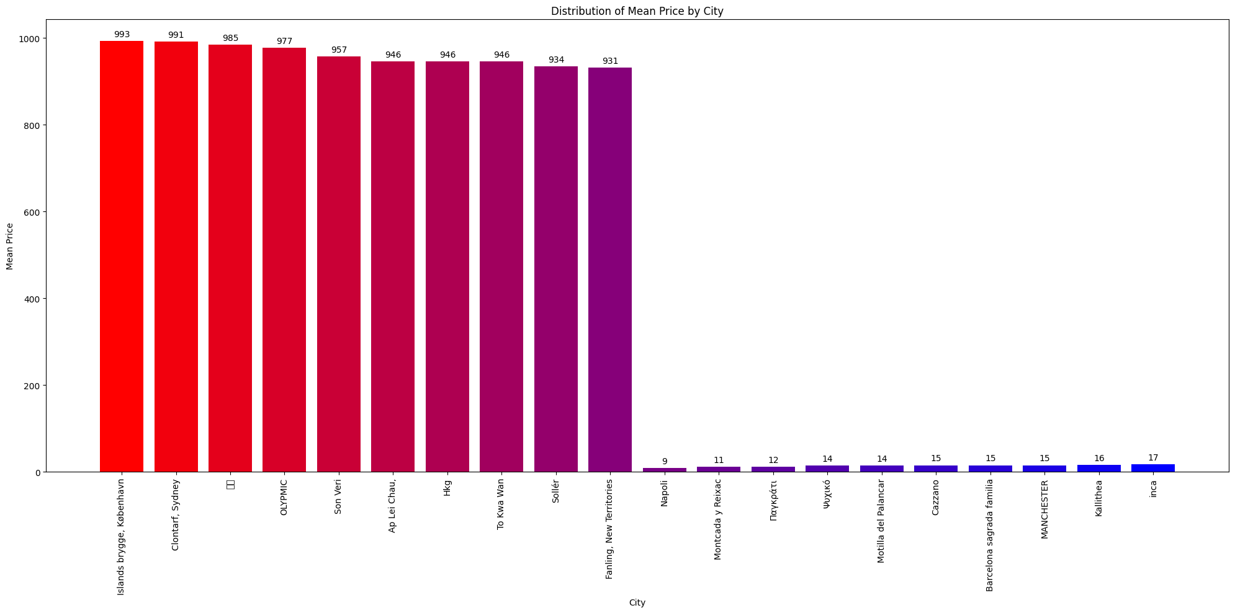
In this graph, we examine the mean prices of all cities and display the ones with the highest (10) and lowest (10) mean prices on AirBnb.
City vs Mean Price
Pricing Trends

Slide 8
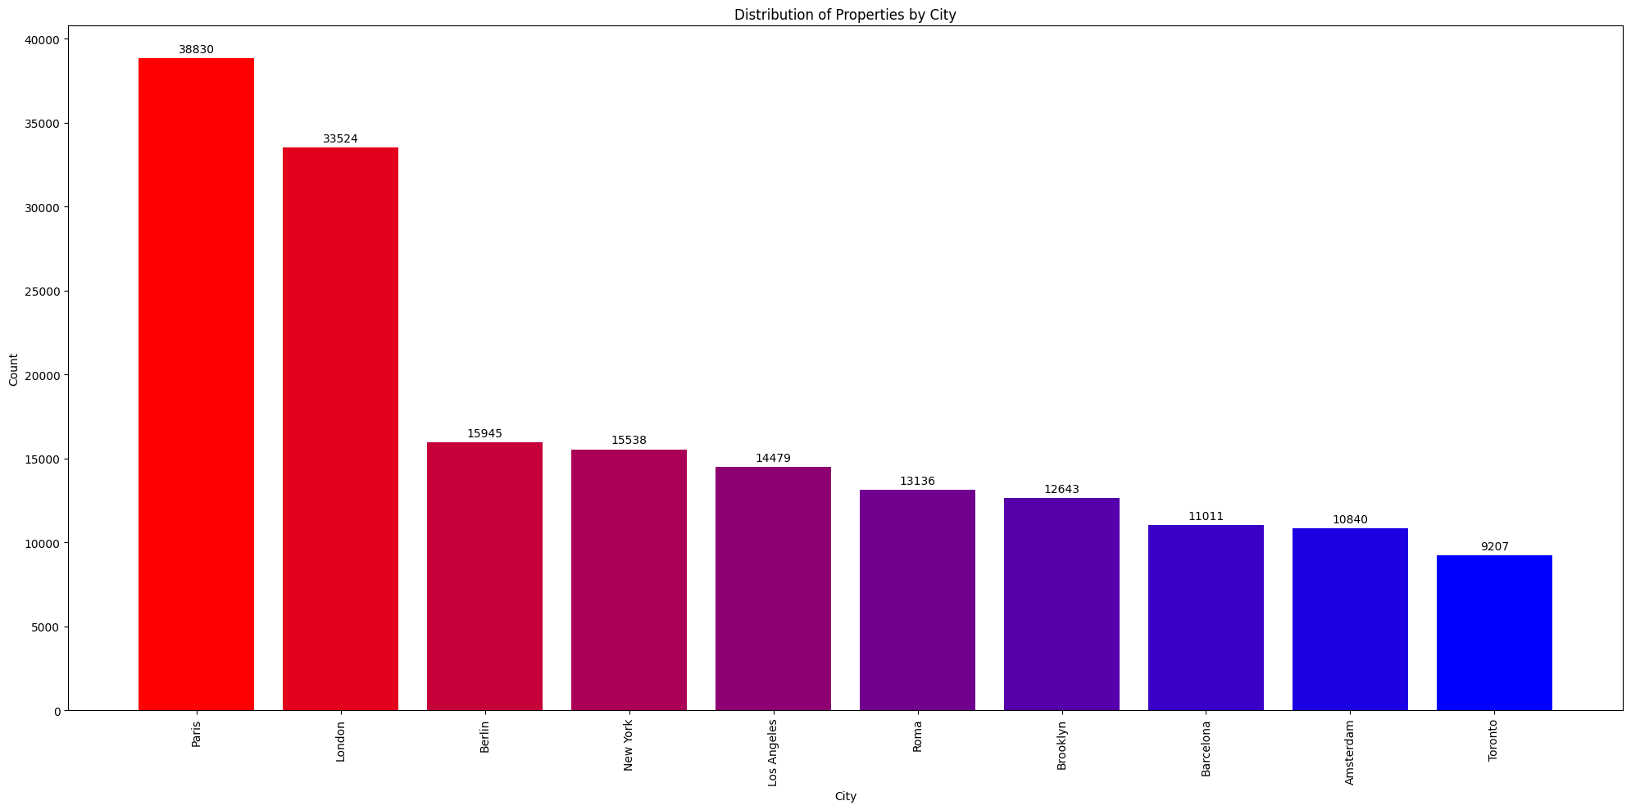
In this graph, we examine the number of listing of all cities and display the cities with the 10 most number of listings on AirBnb.
City vs Number of Listings
Listing Trends

Slide 9
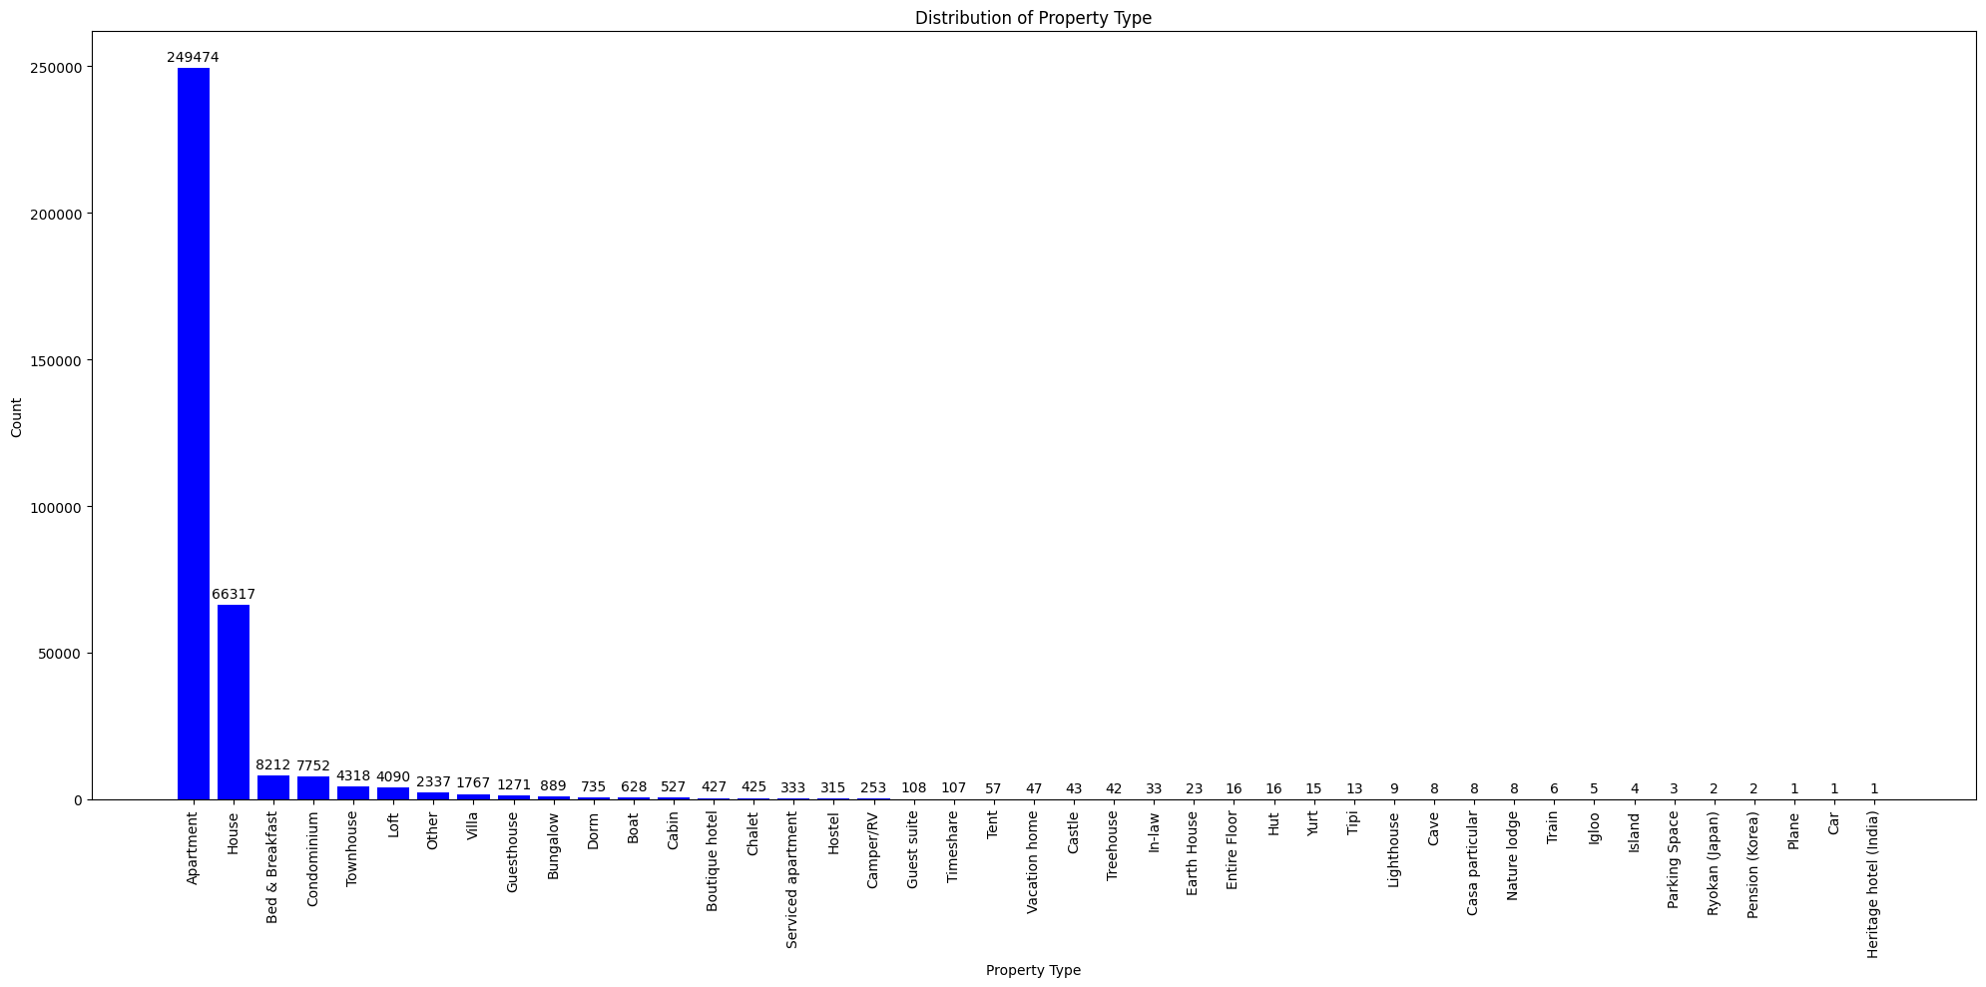
In this graph, we examine the count of each property type listed on AirBnb. This analysis is irrespective of the city.
Property Type vs Count
Property Insights - Type

Slide 10
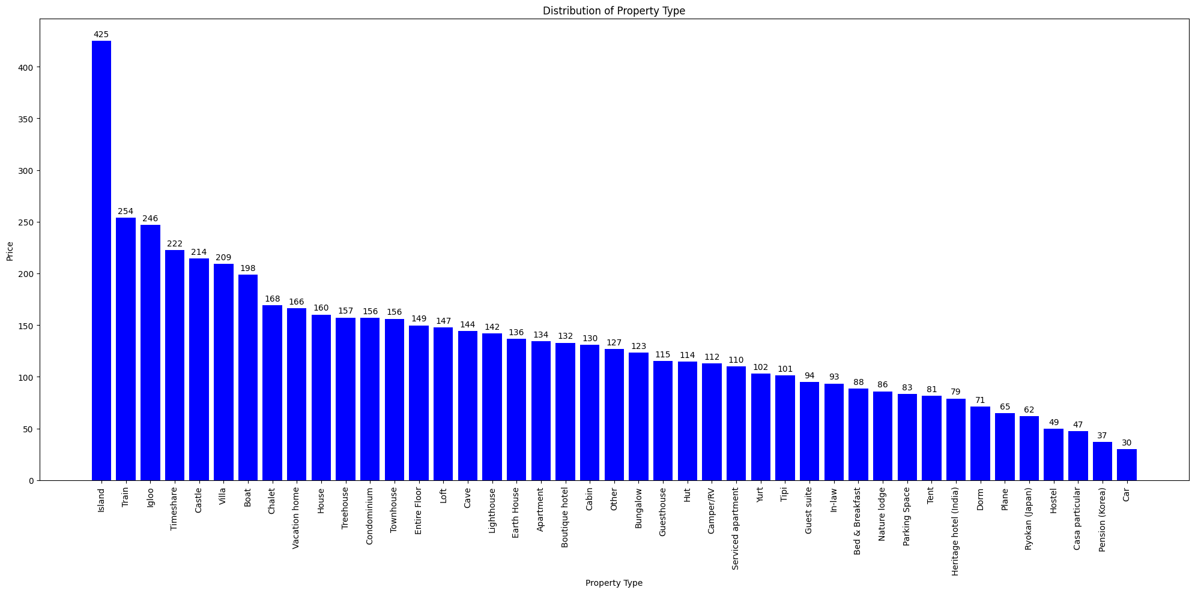
In this graph, we examine the mean price for each property type listed on AirBnb. This analysis is irrespective of the city.
Property Type vs Price
Pricing - Property Type

Slide 11
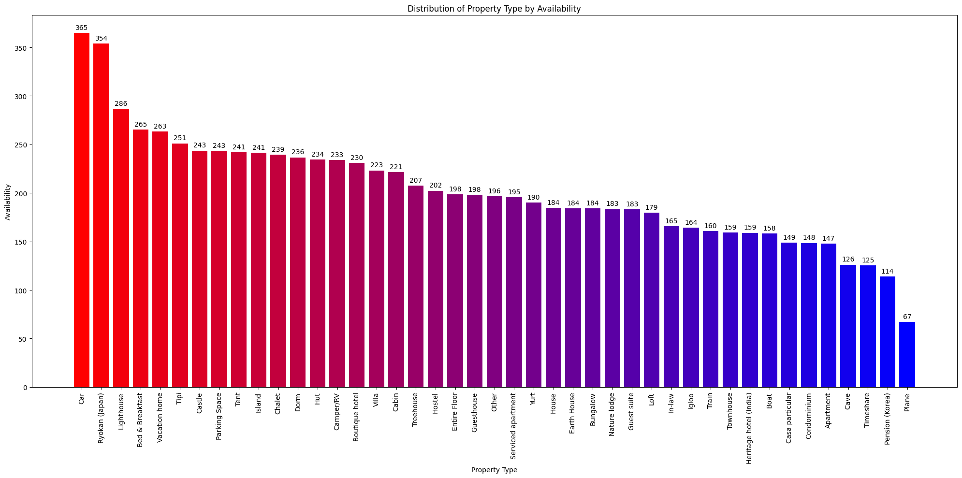
In this graph, we examine the availability for all listed property types on AirBnb.
Property Type vs Availability
Availability - Property Type

Slide 12
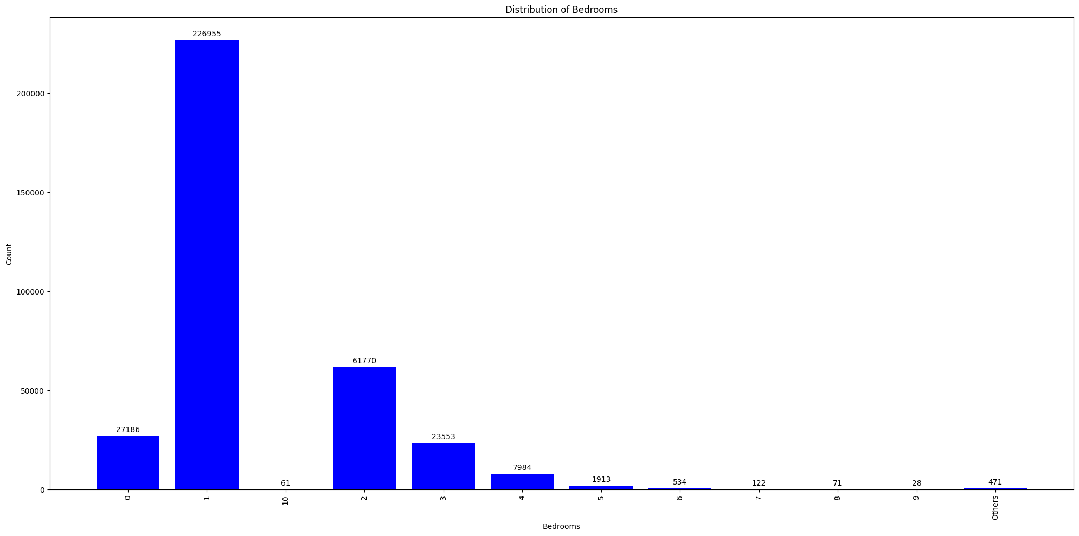
In this graph, we examine the count of all listed number of bedrooms on AirBnb. This analysis is irrespective of the location.
Number of Bedrooms vs Count
Property Insights - Bedrooms

Slide 13
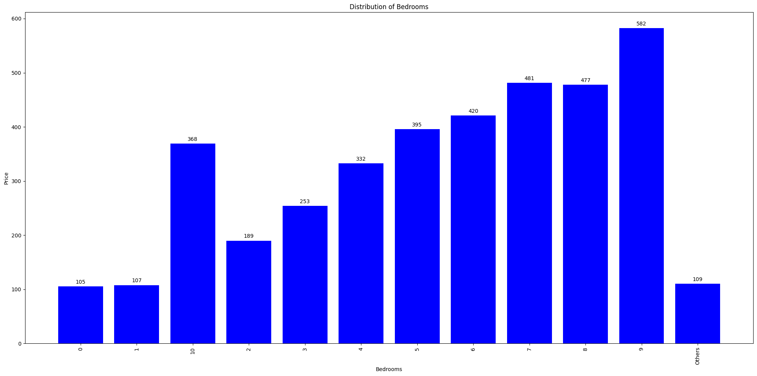
In this graph, we examine the mean price for all listed number of bedrooms on AirBnb. This analysis is irrespective of the location.
Number of Bedrooms vs Price
Pricing - Bedrooms

Slide 14
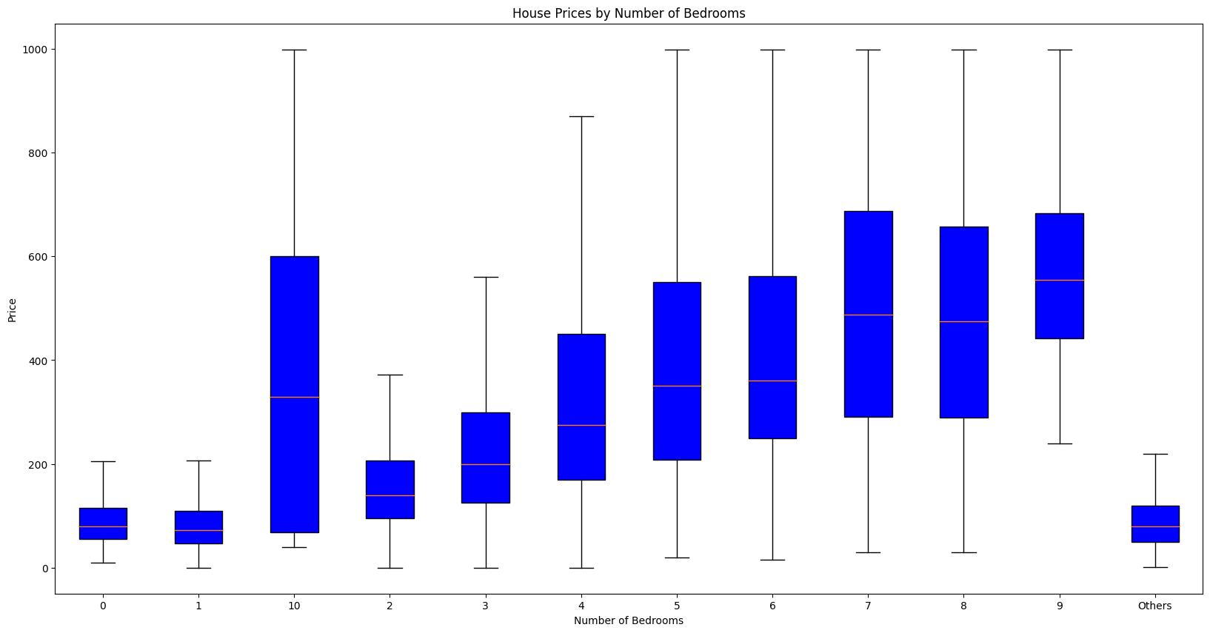
In this graph, we examine the variance in price for all the number of bedrooms listed on AirBnb.
Number of Bedrooms vs Price
Pricing- Bedrooms

Slide 15
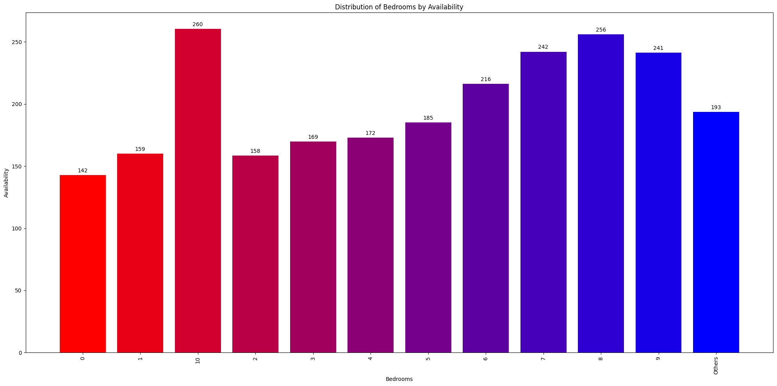
In this graph, we examine the availability for all listed number of bedrooms on AirBnb.
Number of Bedrooms vs Availability
Availability - Bedrooms

Slide 16
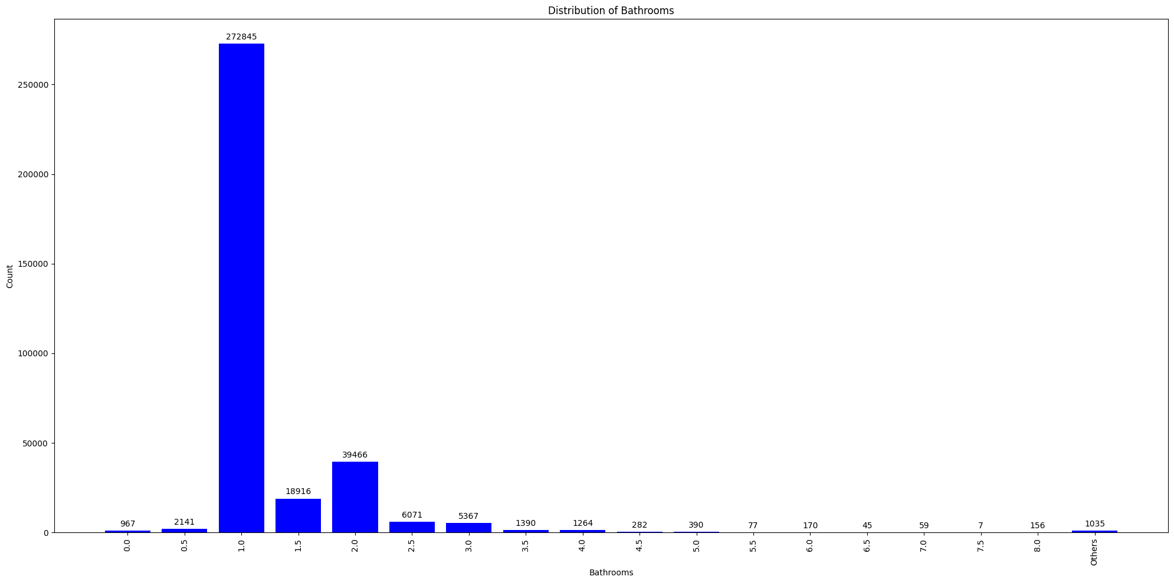
In this graph, we examine the count of all listed number of bathrooms on AirBnb. Unlike bedrooms, AirBnb allows consideration for half bathrooms. This analysis also is irrespective of the location.
Number of Bathrooms vs Count
Property Insights - Bathrooms

Slide 17
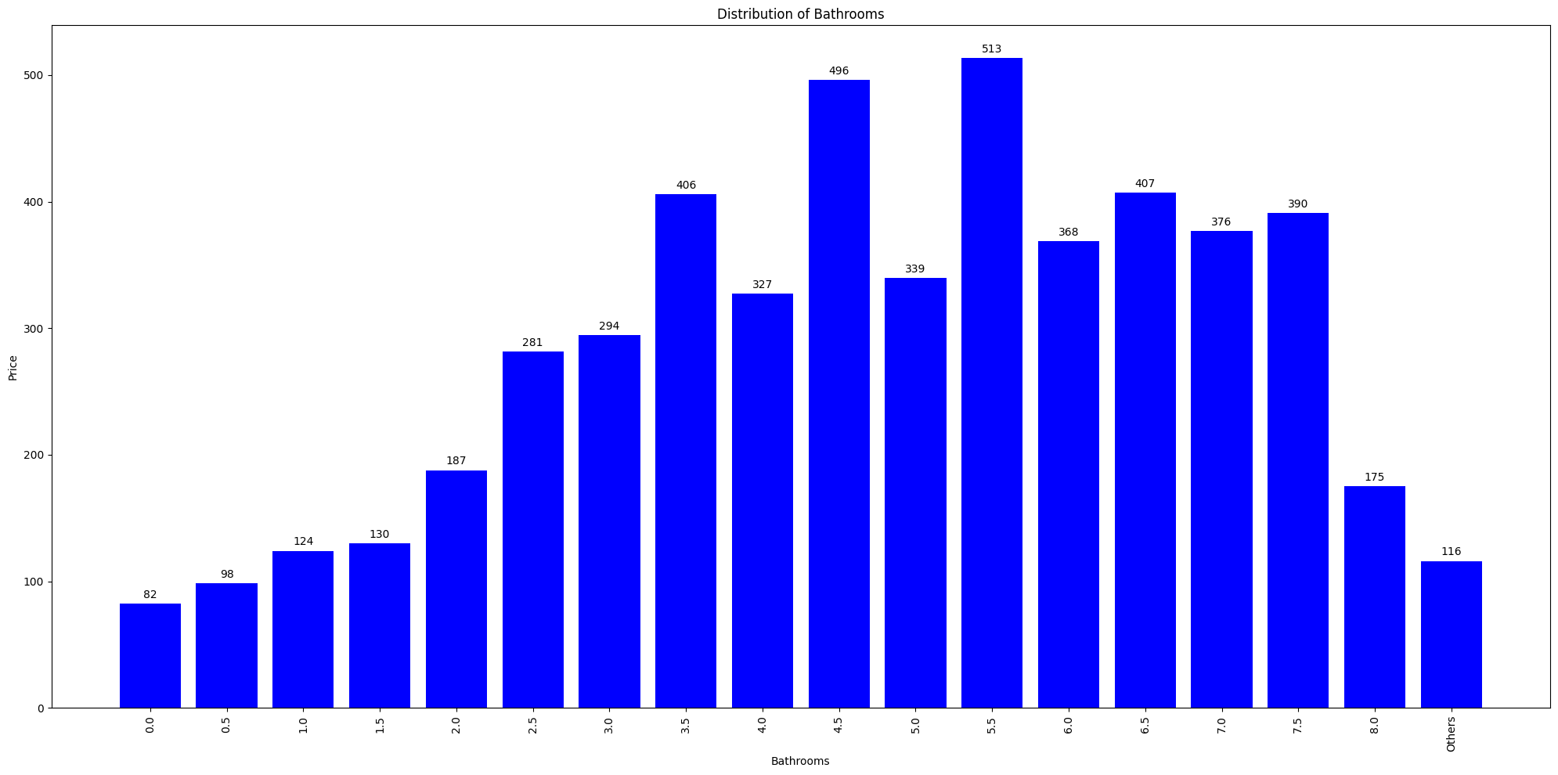
In this graph, we examine the mean price for all listed number of bathrooms on AirBnb. Unlike bedrooms, AirBnb allows consideration for half bathrooms. This analysis also is irrespective of the location.
Number of Bathrooms vs Price
Pricing - Bathrooms

Slide 18
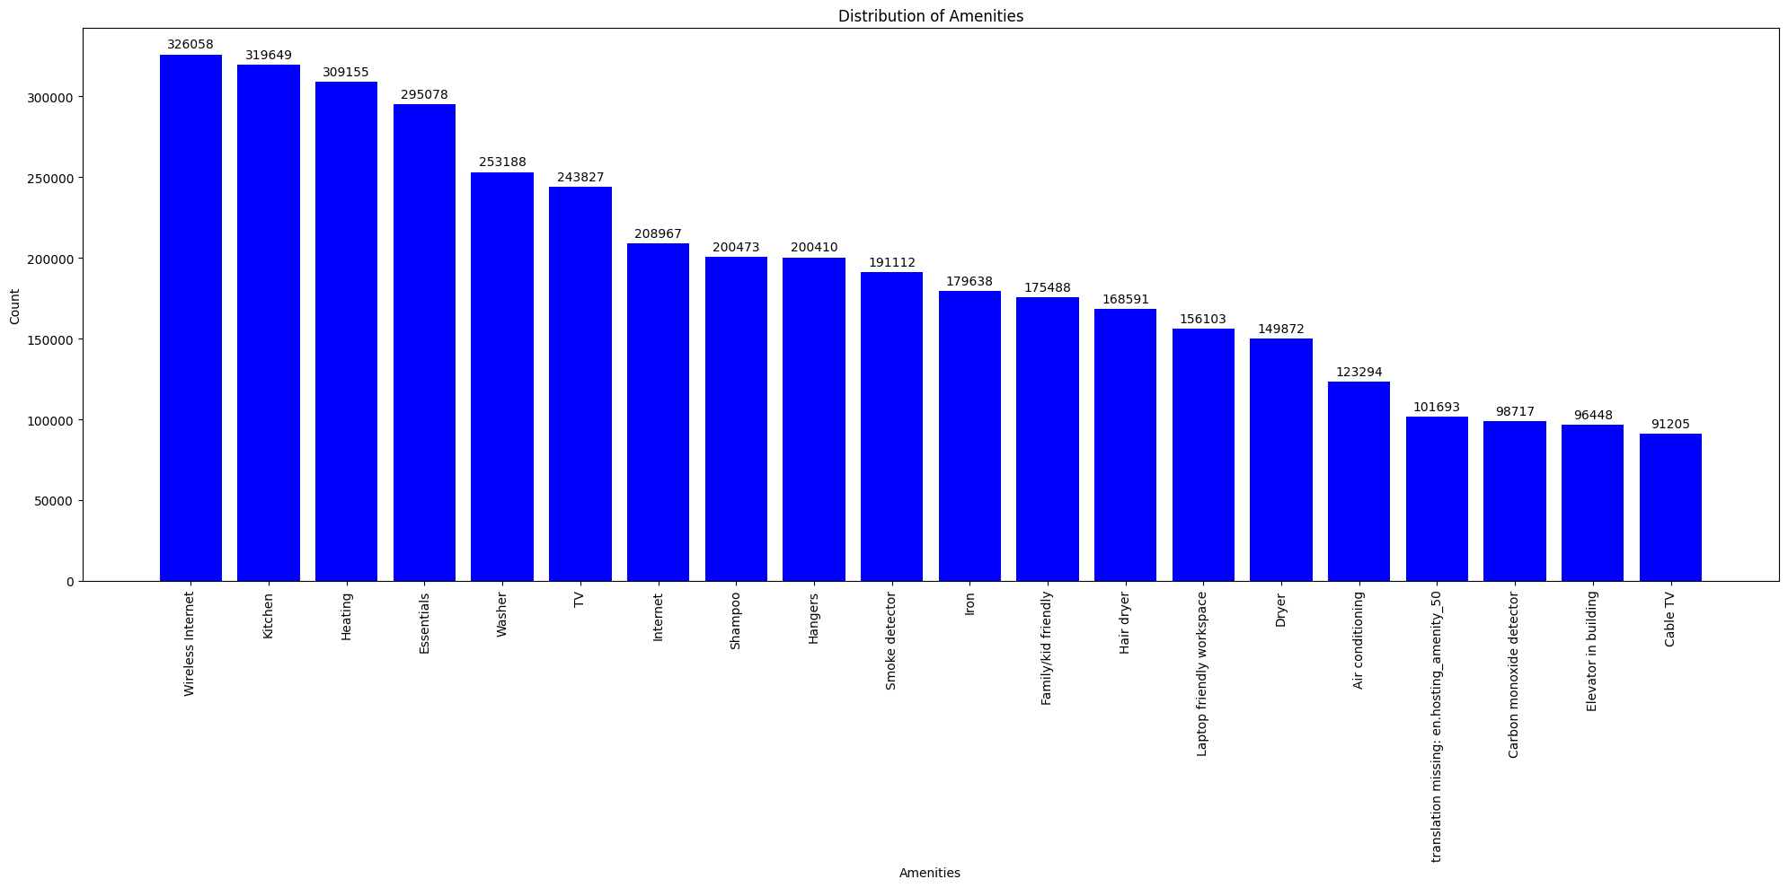
In this graph, we examine the count of properties that list a particular amenity (top 20).
Amenities vs Count
Property Insights - Amenities

Slide 19
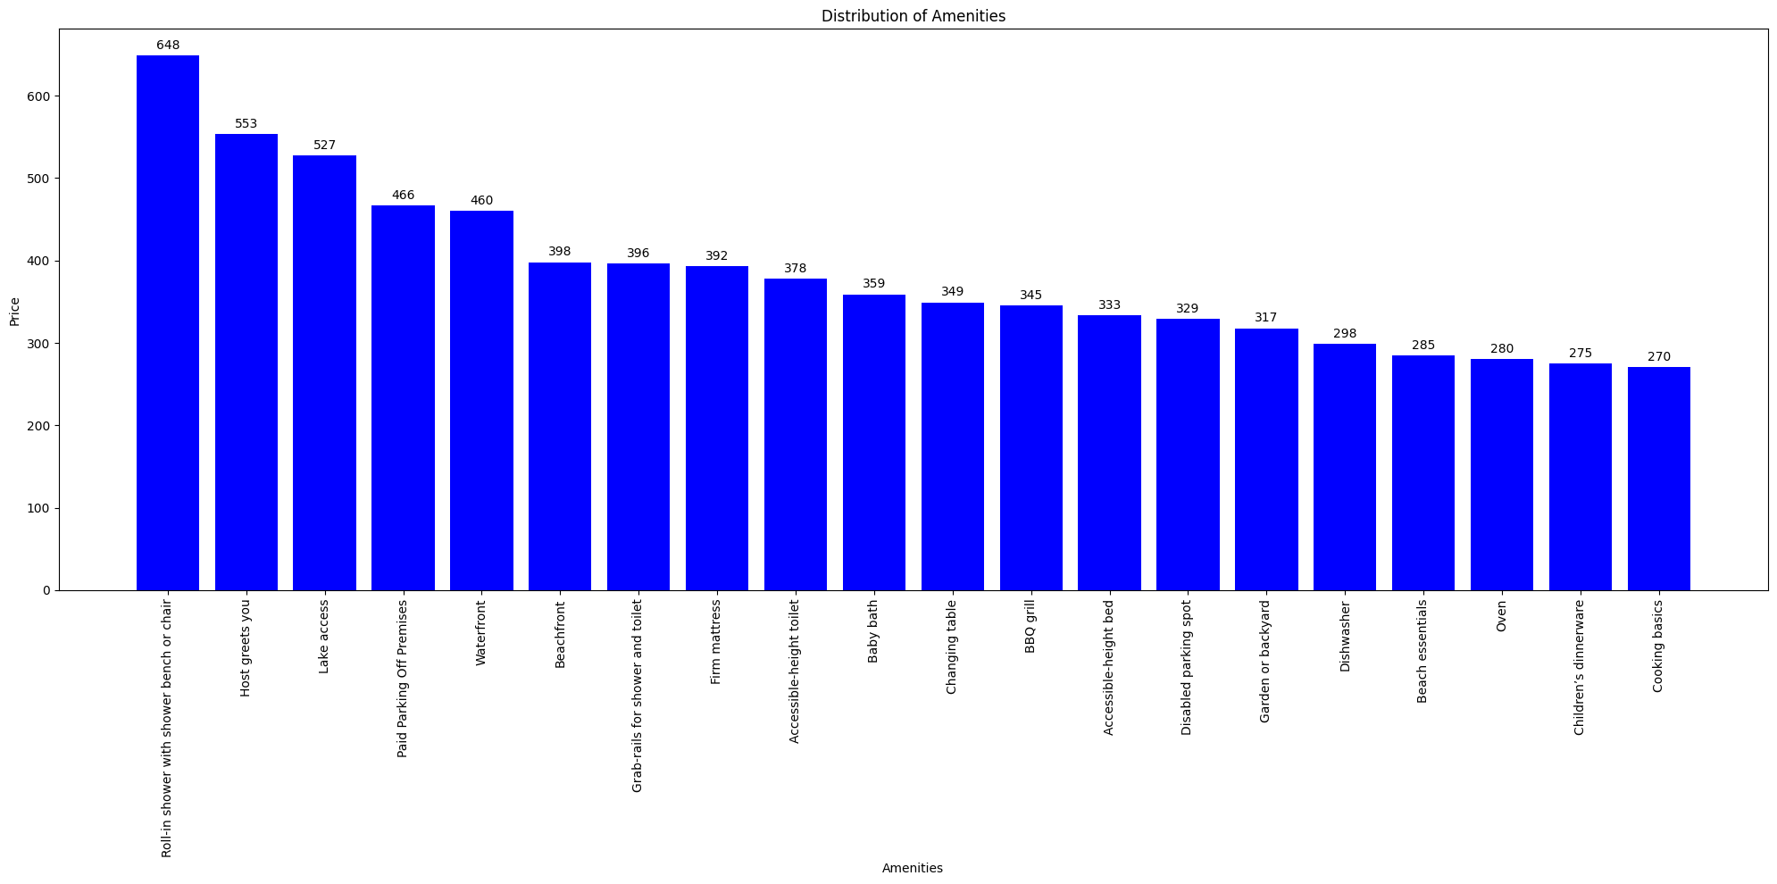
In this graph, we examine the mean for for every amenity (top 20) on AirBnb.
Amenities vs Pricing
Pricing - Amenities

Slide 20
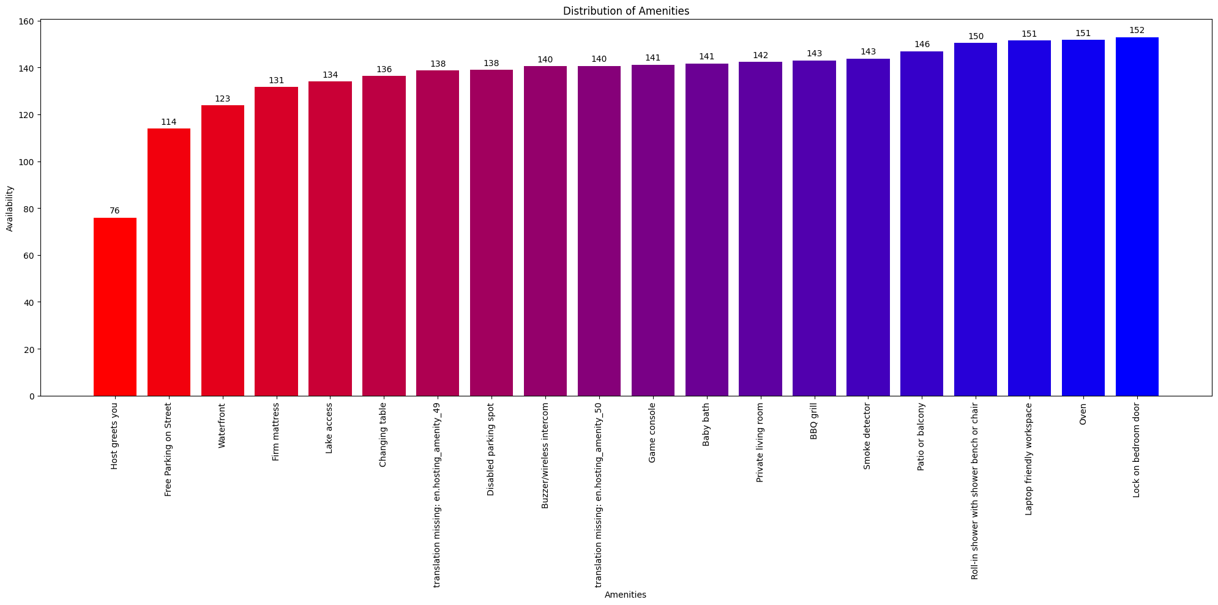
In this graph, we examine the availability of properties based on the amenities listed (top 20).
Amenities vs Availability
Availability - Amenities

Slide 21
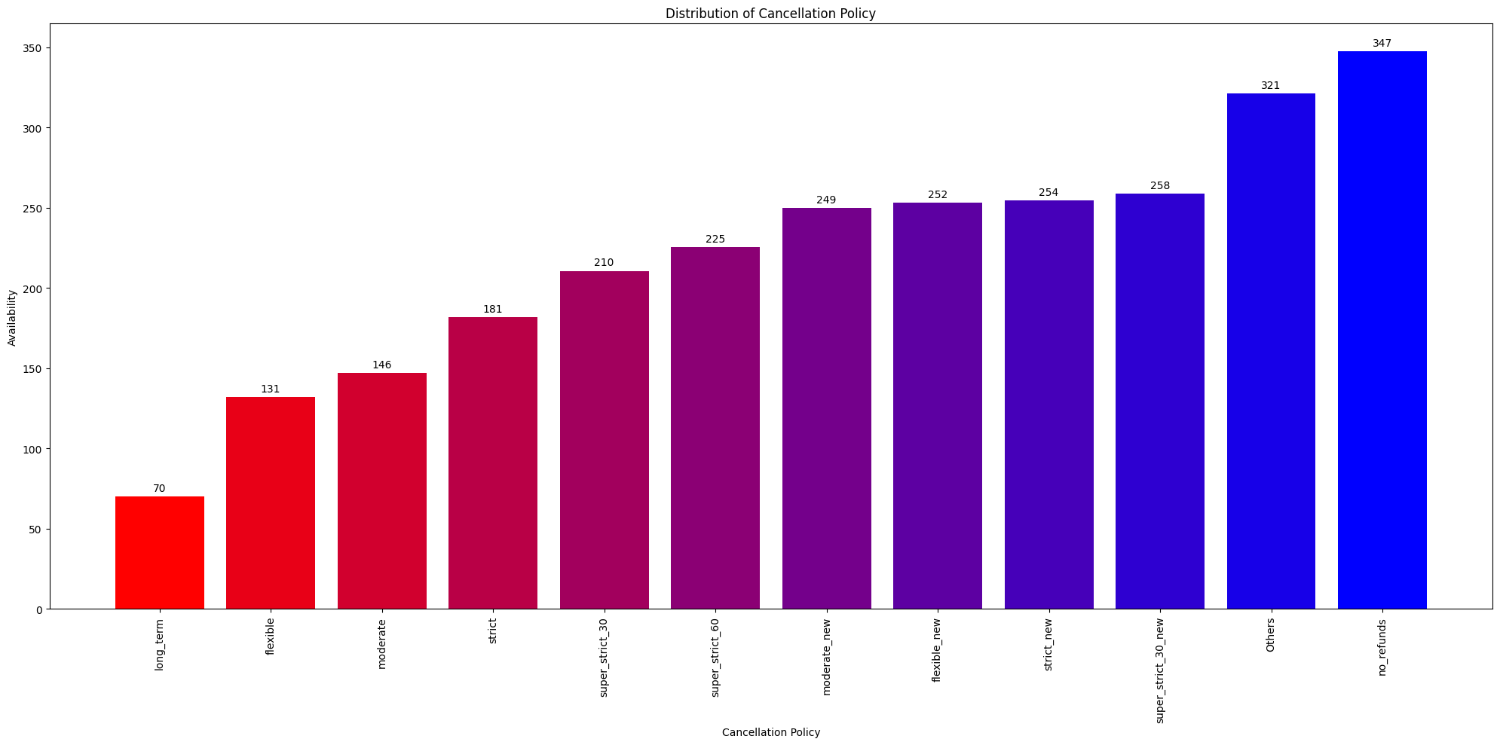
In this graph, we examine the availability of properties based on their cancellation policies.
Cancellation Policy vs Availability
Availability - Cancellation

Slide 22
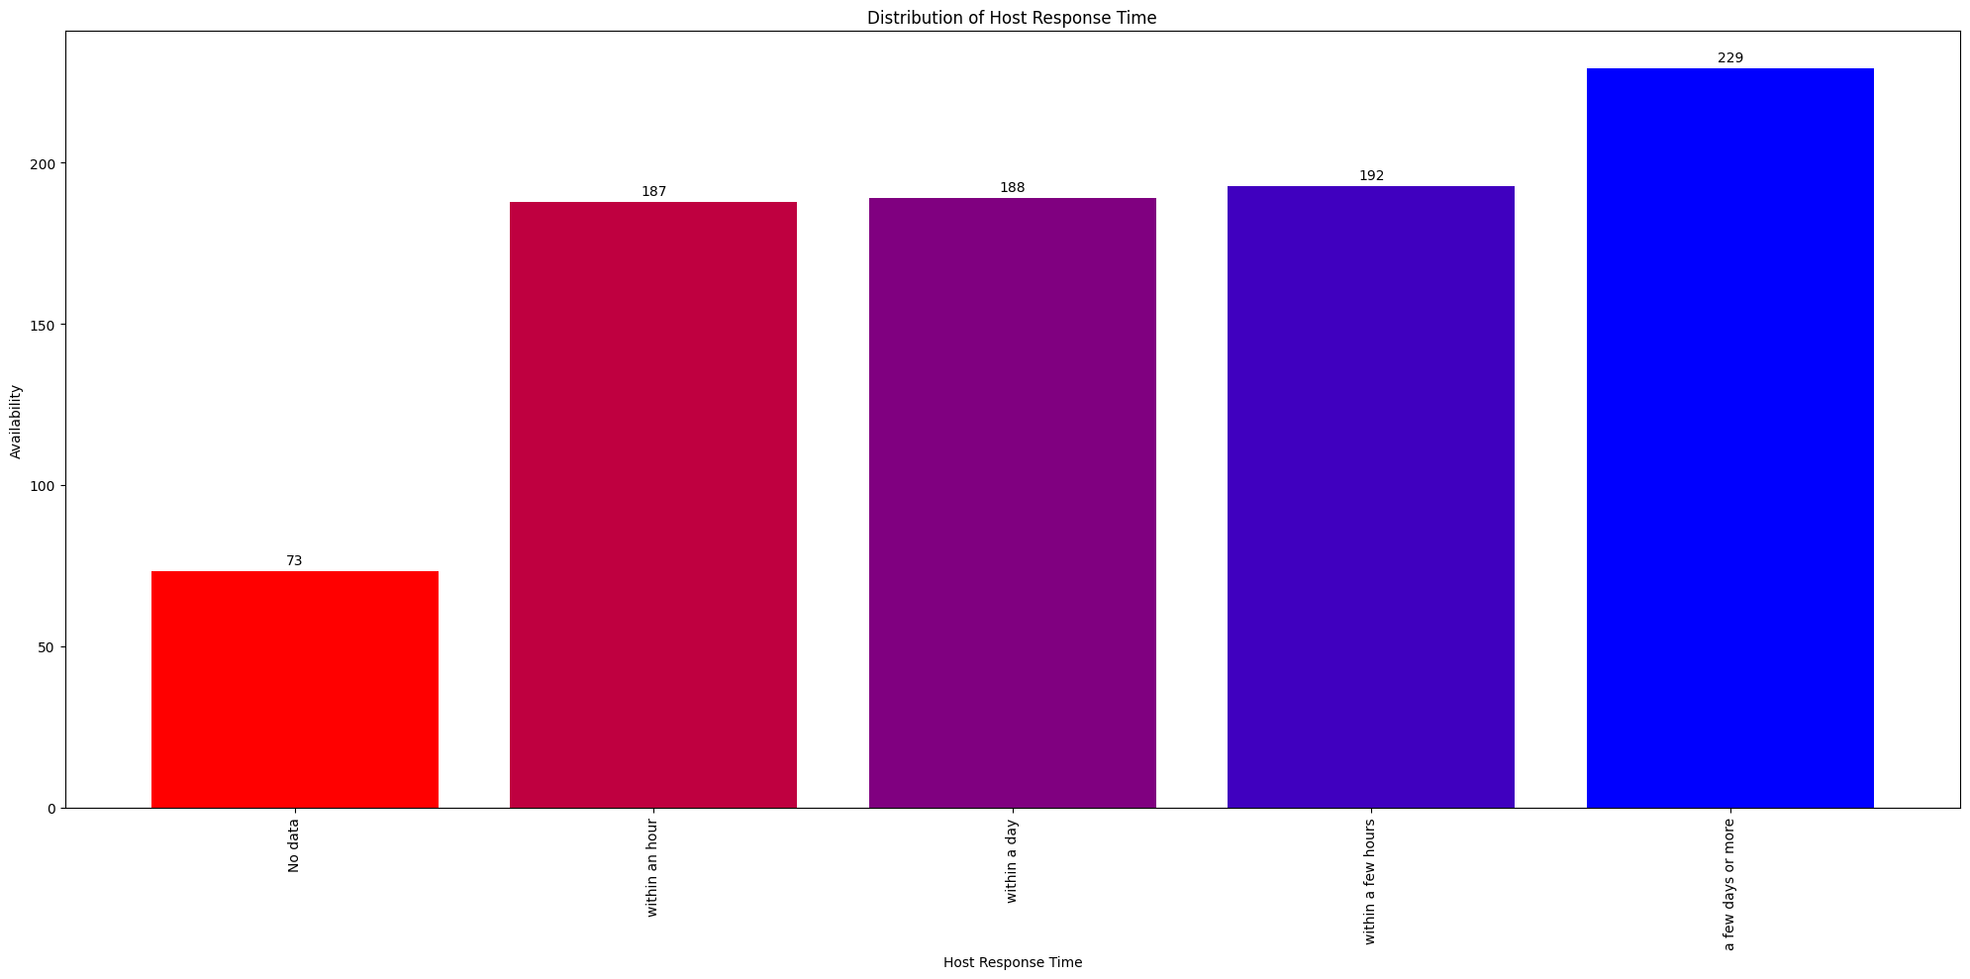
In this graph, we examine the availability of properties based on the response time of the host.
Host Response Time vs Availability
Availability - Response Time

Slide 23
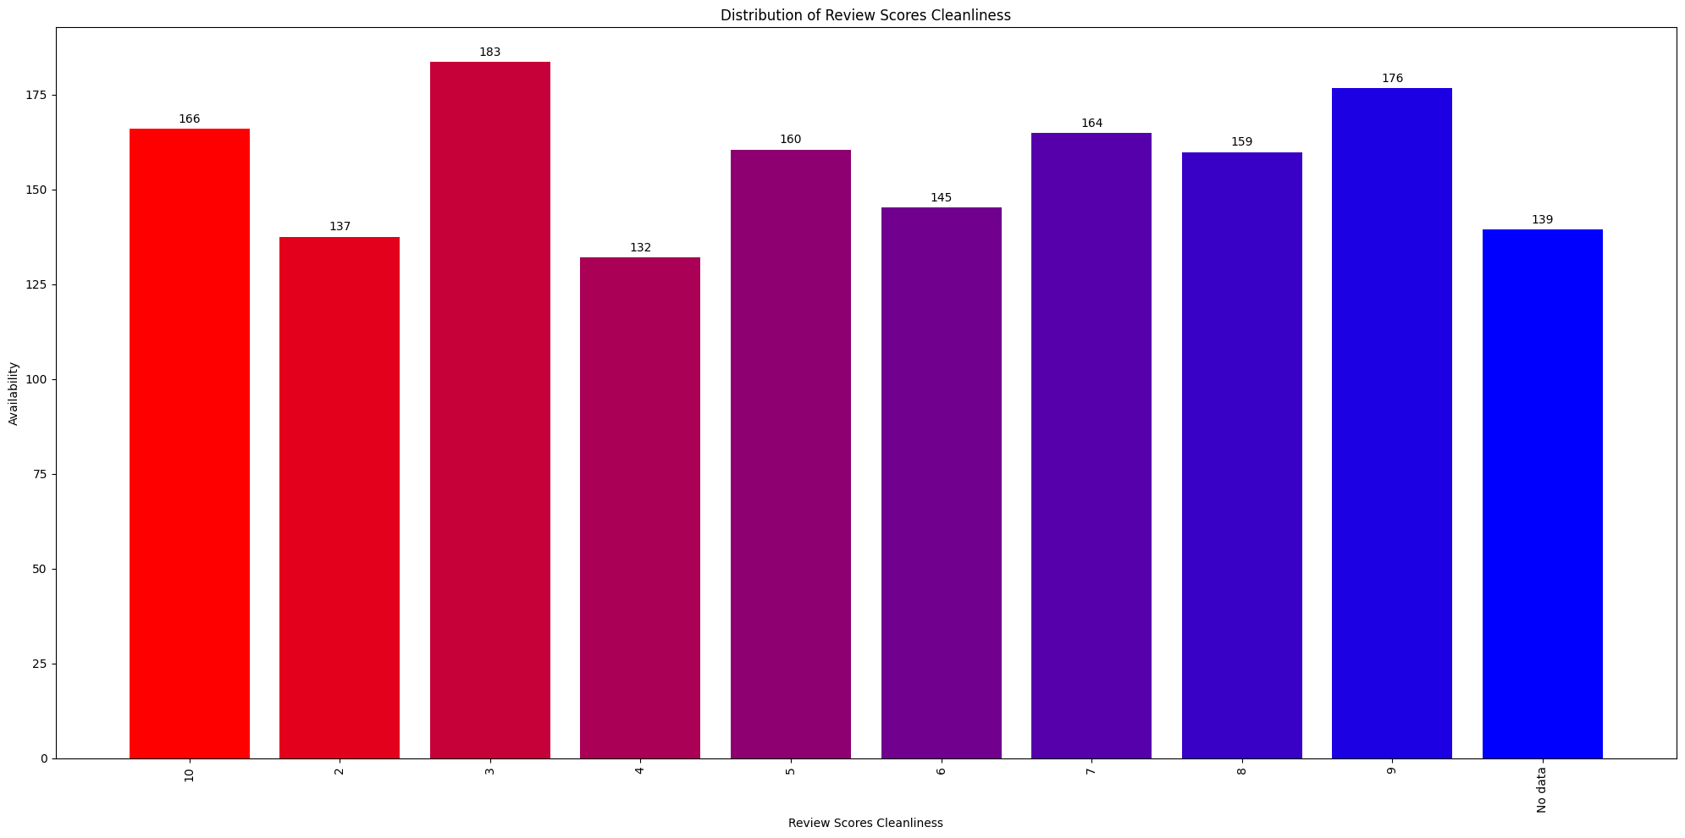
In this graph, we examine the availability of properties based on the cleanliness score given by the users.
Review Score Cleanliness vs Availability
Availability - Cleanliness

Slide 24
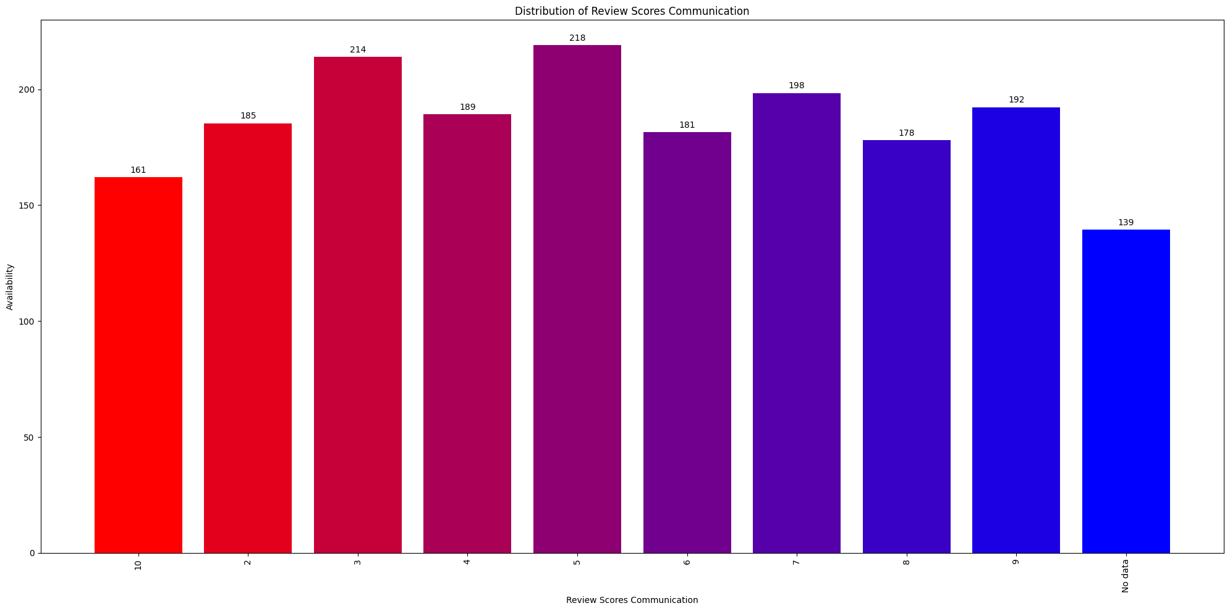
In this graph, we examine the availability of properties based on the communication score given by the users.
Review Score Communication vs Availability
Availability - Communication

Slide 25
Challenges
Our primary challenge was pre-processing the dataset. Since the dataset had nearly half a million rows, we were unable to analyze every single scenario, and ended up giving some leeway for this. For example: While processing the cities, we did not remove special characters, since some cities contain hyphens or are named using non-English characters.
We could not achieve certain points from our proposal, since we did not have sufficient data regarding the customer profile and trends. For example: We wanted to analyze the guests’ reasons for travel, but this information was unavailable to us.
PySpark does not have an inbuilt data visualization tool. Due to this, we had to transfer the processed data to a pandas dataframe and then run the visualization via matplotlib.

Slide 26
Way Forward
Based upon the region, we can conduct further research into the patterns observed within the city. For example: Paris is the most popular city from our dataset. However, this gives no indication of the property distribution and preferences within the larger Paris metropolitan area.
We can also conduct a time series analysis of the popularity of locations and customer preferences. For example: During certain times, such at the 2022 FIFA World Cup, Qatar would have been an incredibly popular choice for AirBnb rentals. On the other hand, during COVID, there would have been a drastic drop in the number of rentals in cities as compared to smaller towns.
Certain columns had descriptive data that would be better processed using NLP tools and algorithms such as NLTK, SpaCy, textblob, etc. For example: ‘Property Summary’, ‘Property Description’, ‘Transit’, ‘House Rules’, ‘Host About’ etc. can be analyzed using NLP technologies.

Slide 27
Lessons Learnt
The most important lesson that we learnt was how to use PySpark to conduct big data analysis.
Since PySpark does not have its own visualization library, we had to explore an alternative option to create our data visualization plots and graphs.
We also learnt how to navigate through the Azure environment, host the data on ADLS, and run our program using Azure Databricks.
It is important to have well-defined objectives and problem statement. This is the key to understanding the way we need to process our data and gain insights.

Slide 28
Conclusion
In this project we have given certain trends to improve the current Airbnb ecosystem by leveraging the limitless potential of big data analytics. We shed light on the operations and implications of the vacation rental market and provide practical insights for hosts, travelers, and industry stakeholders by analyzing the Airbnb Global Listings dataset in depth. We found hidden trends and correlations to enable data-driven decision-making and influence plans in the hospitality industry by leveraging a complex technology stack, including Apache Spark, ADLS, and coexisting Python libraries. We hope that the information gathered from this project will help create a more knowledgeable and effective market for all parties, especially Airbnb, involved in the ever-growing property rental and sharing market.

Slide 29
Thank You!

